Slide 1
Cryptography I
General concepts and some classical ciphers

Slide 2
Basic concepts
Attack models
Classic ciphers: mono-alphabetic
Vigenere cipher
One-time-pad cipher

Slide 3
Security Goals
Confidentiality (secrecy, privacy)
  Assure that data is accessible to only one who are authorized to know
Integrity
  Assure that data is only modified by authorized parties and in authorized ways
Availability
  Assure that resource is available for authorized users

Slide 4
General tools
Cryptography
Software controls
Hardware controls
Policies and procedures
Physical controls

Slide 5
What is Crypto?
Constructing and analyzing cryptographic protocols which enable parties to achieve security objectives
  Under the present of adversaries.
A protocol (or a scheme) is a suite of procedures that tell each party what to do
  usually, computer algorithms
Cryptographers devise and analyze protocols under Attack model
  assumptions about the resources and actions available to the adversary
    So, you need to think as an adversary

Slide 6
Terms
Cryptography: the study of mathematical techniques for providing information security services.
Cryptanalysis: the study of mathematical techniques for attempting to get security services breakdown.
Cryptology: the study of cryptography and cryptanalysis.

Slide 7
Terms …
plaintexts
ciphertexts
keys
encryption
decryption
Y=E_{Z}(X)
Y
X=D_{Z’}(Y)
Sender Alice
Receiver Bob
Key Z
Enemy/Adversary Eve
Key Z’

Slide 8
Secret-key cryptography
Also called: symmetric cryptography
Use the same key for both encryption & decryption (Z=Z’)
Key must be kept secret
Key distribution – how to share a secret between A and B very difficult

Slide 9
Public-key cryptography
Also called: asymmetric cryptography
Encryption key different from decryption key and
  It is not possible to derive decryption key from encryption key
Higher cost than symmetric cryptography

Slide 10
Is it a secure cipher system?
Why insecure
  just break it under a certain reasonable attack model (show failures to assure security goals)
Why secure:
  Evaluate/prove that under the considered attack model, security goals are assured
  Provable security: Formally show that (with mathematical techniques) the system is as secure as a well-known secure one (usually simpler).

Slide 11
Breaking ciphers …
There are different methods of breaking a cipher, depending on:
  the type of information available to the attacker
  the interaction with the cipher machine
  the computational power available to the attacker

Slide 12
Breaking ciphers …
Ciphertext-only attack:
  The cryptanalyst knows only the ciphertext.
  Goal: to find the plaintext and the key.
  NOTE: such vulnerable is seen completely insecure
Known-plaintext attack:
  The cryptanalyst knows one or several pairs of ciphertext and the corresponding plaintext.
  Goal: to find the key used to encrypt these messages
    or a way to decrypt any new messages that use the same key (although may not know the key).

Slide 13
Breaking ciphers …
Chosen-plaintext attack
  The cryptanalyst can choose a number of messages and obtain the ciphertexts for them
  Goal: deduce the key used in the other encrypted messages or decrypt any new messages (using that key).
Chosen-ciphertext attack
  Similar to above, but the cryptanalyst can choose a number of ciphertexts and obtain the plaintexts.
Both can be adaptive
  The choice of ciphertext may depend on the plaintext received from previous requests.

Slide 14
Models for Evaluating Security
Unconditional (information-theoretic) security
  Assumes that the adversary has unlimited computational resources.
  Plaintext and ciphertext modeled by their distribution
  Analysis is made by using probability theory.
  For encryption systems: perfect secrecy, observation of the ciphertext provides no information to an adversary.

Slide 15
Models for Evaluating Security
Provable security:
  Prove security properties based on assumptions that it is difficult to solve a well-known and supposedly difficult problem (NP-hard …)
    E.g.: computation of discrete logarithms, factoring
Computational security (practical security)
  Measures the amount of computational effort required to defeat a system using the best-known attacks.
  Sometimes related to the hard problems, but no proof of equivalence is known.

Slide 16
Models for Evaluating Security
Ad hoc security (heuristic security):
  Variety of convincing arguments that every successful attack requires more resources than the ones available to an attacker.
  Unforeseen attacks remain a threat.
  THIS IS NOT A PROOF

Slide 17
Classic ciphers

Slide 18
Shift cipher (additive cipher)
Key Space: [1 .. 25]
Encryption given a key K:
  each letter in the plaintext P is replaced with the K’th letter following corresponding number (shift right):
  Another way: Y=X ⊕ K ➔ additive cipher
Decryption given K:
  shift left
  A B C D E F G H I J K L M N O P Q R S T U V W X Y Z
  0 1 2 3 4 5 6 7 8 9 10 11 12 13 14 15 16 17 18 19 20 21 22 23 24 25
  P = CRYPTOGRAPHYISFUN
  K = 11
  C = NCJAVZRCLASJTDQFY

Slide 19
Shift Cipher: Cryptanalysis
Easy, just do exhaustive search
  key space is small (<= 26 possible keys).
  once K is found, very easy to decrypt

Slide 20
General Mono-alphabetical Substitution Cipher
The key space: all permutations of Σ = {A, B, C, …, Z}
Encryption given a key π:
  each letter X in the plaintext P is replaced with π(X)
Decryption given a key π :
  each letter Y in the cipherext P is replaced with π⁻¹(Y)
Example:
A B C D E F G H I J K L M N O P Q R S T U V W X Y Z
π = B A D C Z H W Y G O Q X S V T R N M S K J I P F E U
BECAUSE → AZDBJSZ

Slide 21
Looks secure, early days
Exhaustive search is infeasible
  key space size is 26! ≈ 4*10²⁶
Dominates the art of secret writing throughout the first millennium A.D.
Thought to be unbreakable by many back then

Slide 22
Cryptanalysis of Substitution Ciphers:
Frequency Analysis
Each language has certain features:
  frequency of letters, or of groups of two or more letters.
Substitution ciphers preserve the mentioned language features ➔ vulnerable to frequency analysis attacks

Slide 23
Substitution Ciphers: Cryptanalysis
The number of different ciphertext characters or combinations are counted to determine the frequency of usage.
The cipher text is examined for patterns, repeated series, and common combinations.
Replace ciphertext characters with possible plaintext equivalents using known language characteristics.
Example:
  THIS IS A PROPER SAMPLE FOR ENGLISH TEXT. THE FREQUENCIES OF LETTERS IN THIS SAMPLE IS NOT UNIFORM AND VARY FOR DIFFERENT CHARACTERS. IN GENERAL THE MOST FREQUENT LETTER IS E FOLLOWED BY A SECOND GROUP. IF WE TAKE A CLOSER LOOK WE WILL NOTICE THAT FOR BIGRAMS AND TRIGRAMS THE NONUNIFORM IS EVEN MORE.
  Observations: f_{x}=1 và f_{A}=15.

Slide 24
The letters in the English alphabet can be divided into 5 groups of similar frequencies
I e
II t,a,o,i,n,s,h,r
III d,l
VI c,u,m,w,f,g,y,p,b
V v,k,j,x,q,z
Some frequently appearing bigrams or trigrams
Th, he, in, an, re, ed, on, es, st, en at, to
The, ing, and, hex, ent, tha, nth, was eth, for, dth.

Slide 25
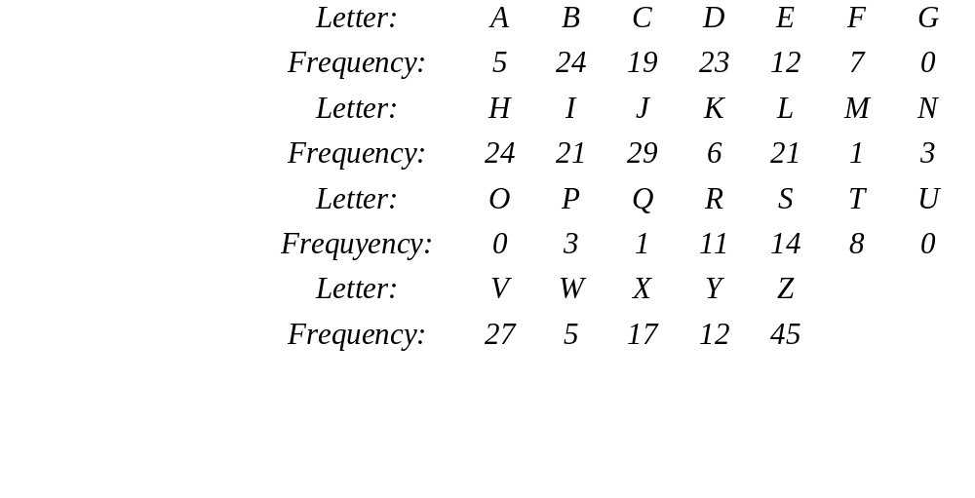
Example
e ⇒ Z
f_{j} = 29, f_{v} = 27
f_{jcz} = 8 → t ⇒ J
h ⇒ C
a ⇒ V
  (article a)
J,V,B,H,D,I,L,C {t,a,o,i,n,s,h,r}
t,a h
JZB = te ? { teo, tei, ten, ter, tes } ➔ n ⇒B

Slide 26
Observations:
  A cipher system should not allow statistical properties of plaintext to pass to the ciphertext.
  The ciphertext generated by a "good" cipher system should be statistically indistinguishable from random text.
Idea for a stronger cipher (1460’s by Alberti)
  use more than one cipher alphabet, and switch between them when encrypting different letters ➔ Poly-alphabetic Substitution Ciphers
  Developed into a practical cipher by Vigenère (published in 1586)

Slide 27
Definition:
  Given m, a positive integer, P = C = (Z₂₆)^{n}, and K = (k₁, k₂, …, k_{m}) a key, we define:
Encryption:
  e_{k} (p₁, p₂… p_{m}) = (p₁+k₁, p₂+k₂…p_{m}+k_{m}) (mod 26)
Decryption:
  d_{k} (c₁, c₂… c_{m}) = (c₁-k₁, c₂-k₂ … c_{m}- k_{m}) (mod 26)
Example:
  Plaintext: C R Y P T O G R A P H Y
  Key: L U C K L U C K L U C K
  Ciphertext: N L A Z E I I B L J J I

Slide 28
Vigenere Cipher: Cryptanalysis
Find the length of the key.
Divide the message into that many shift cipher encryptions.
Use frequency analysis to solve the resulting shift ciphers.

Slide 29
One-Time Pad
Key is chosen randomly
Plaintext X = (x₁ x₂ … x_{n})
Key K = (k₁ k₂ … k_{n})
Ciphertext Y = (y₁ y₂ … y_{n})
e_{k}(X) = (x₁+k₁ x₂+k₂ … x_{n}+k_{n}) mod m
d_{k}(Y) = (y₁-k₁ y₂-k₂ … y_{n}-k_{n}) mod m

Slide 30
Example
Plaintext space = Ciphtertext space =
Keyspace = {0,1}^{n}
Key is chosen randomly
For example:
Plaintext is 10001011
Key is 00111001
Then ciphertext is 10110010

Slide 31
Main points in One-Time Pad
The key is never to be reused
  Thrown away after first and only use
  If reused ➔ insecure!
One-Time Pad uses a very long key, exactly the same length as of the plaintext
  In old days, some suggest choose the key as texts from, e.g., a book ➔ i.e. not randomly chosen
    Not One-Time Pad anymore ➔ this does not have perfect secrecy as in true One-Time-Pad and can be broken
  Perfect secrecy means key length be at least message length
    Difficult in practice!

Slide 32
Shift ciphers are easy to break using brute force attacks (eshautive key search)
Substitution ciphers preserve language features (in N-gram frequency) and are vulnerable to frequency analysis attacks.
Vigenère cipher are also vulnerable to frequency analysis once the key length is found.
  In general poly-alphabetical substitution ciphers are not that secure
OTP has perfect secrecy if the key is chosen randomly in the message length and is used only once.

Slide 33
http://pc.vietica.com/van.nguyen/InfoSec-VietNhat/InfoSec.htm

